Slide 1

Online power management with Quality-of-Service Consideration for Bluetooth Low Energy
Prof. Ya-Shu Chen
Jing-Ho Chen
Notes:
對於無線感測網路系統下 Qulaity of Service 在BLE 中power management上的議題

Slide 2

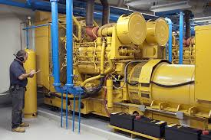

Introduction
● Intelligent sensor network
-Sensing information
-Real-time monitor
● Application
- Body sensor network
- Military
- Industry monitor
Intelligent Buildings
Predictive Maintenance
Healthcare
Notes:
現今智能體系(居家 & 城市) 已漸漸展開，立即性的吸收到周遭感測訊息與監控控制議題也越來越多人探討，若要組織如此龐大的體系上
感測節點就佔有一席重要地位，需要能監控周圍資訊、處理且回傳做監控，這些流程對於感測器來說是基本過程
(就我們熟知的感測器(小米 jawbone)是具有感測人生裡資訊且能回傳資料給使用者觀看)
http://www.ithome.com.tw/news/97980
https://smartcitizen.me/pages/smartcitizen
一個完整的物聯網體系需具備三個要素，分別為感知、傳輸及智能處理
無線嵌入式裝置的需求性
感測需求量擴增
無線傳輸必要性
2015/8/11
這個智慧市民感測裝置（Smart Citizen Kit，簡稱SCK）是由歐盟贊助推動的一項智慧城市計畫，”阿姆斯特丹”在去年3月發表了第一版市民感測裝置，提供免費的感測裝置讓市民帶回家。
目前在全球各地區布建了1,187個裝置，將近6千個感測器，累積5千萬筆資料，所有資訊都被即時傳送到線上資料平臺。

Slide 3
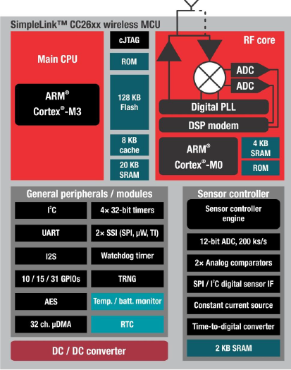
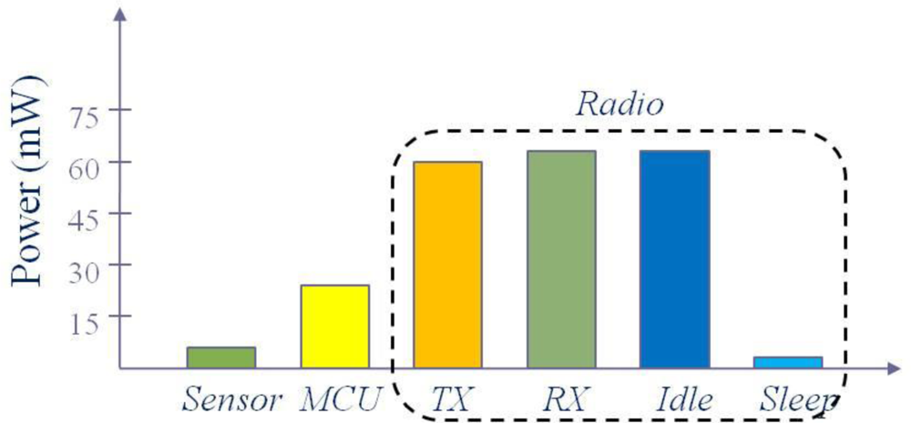
Motivation
● Real-time
- Emergency treatment
- Real time hardware
● Battery capacity
-Varied applications data rate
-Power consumption (Transmission power)
http://www.ti.com/lit/ug/swcu117d/swcu117d.pdf [CC13xx, CC26xx SimpleLink™ Wireless MCU Technical Reference Manual]
Notes:
Radio上的耗能尤為嚴重，所造成的radio consumption有許多的設計上的solution
因此我們選用BLE最佳的傳輸方案來做為我們的傳輸protocol

Slide 4
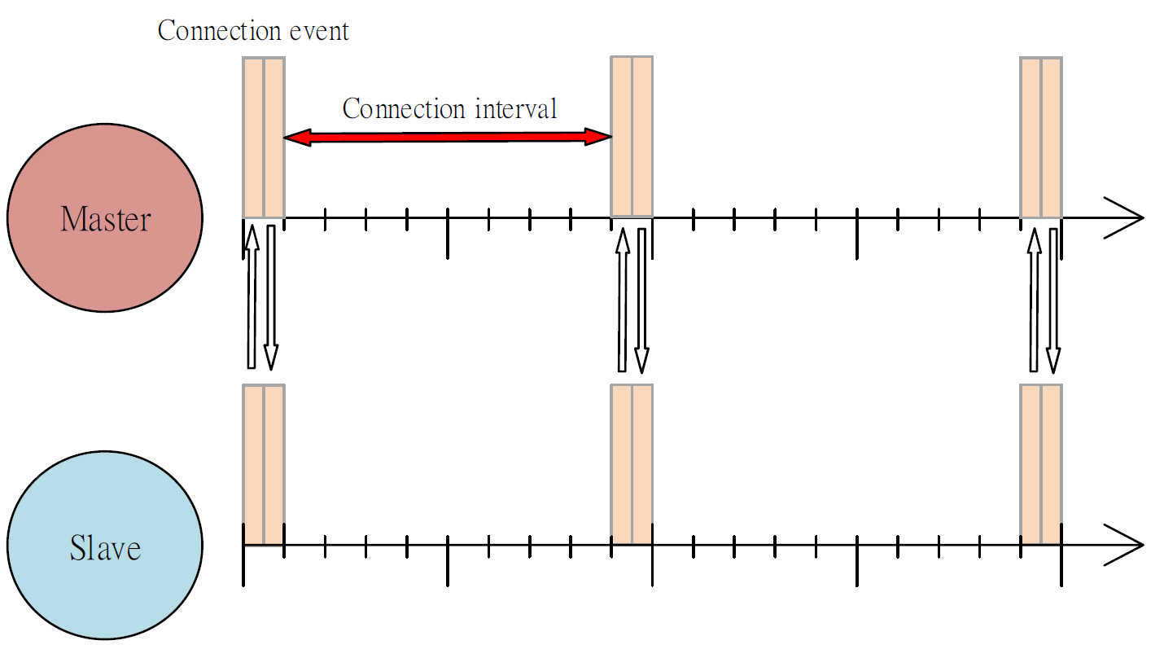
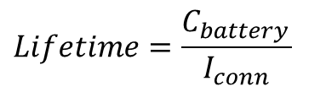
BLE Protocol
● Bluetooth Low Energy (BLE)
- BLE is designed to reduce power consumption and merged into Bluetooth standard
in 2010.
- The distance between two connection events for notifying each status is called
connection interval.
$$Lifetime=\frac{C_{battery} }{I_{conn}}$$
http://www.summitdata.com/blog/ble-overview/
Notes:
說出重點，且舉出非線性
遇到問題
-單一節點上connection interval調整 <Application>
-Star 上的問題 (send-and-confirm)
-Mesh propose

Slide 5
Star Topology
●Connection interval assignment
-Master-Slave architecture
-Synchronization
-Collision constraint
●Assign interval with multiple devices
-There is only one master to manage the multiple sensing data from multiple slaves.
-The multiple slaves need to be synchronize with master and master should wait only
one device at one time.
-In the multiple slaves, there has the collision constraint without write-request scheduler.
Connection interval of Slave1
Connection interval of Slave2
Slave3
Master
Master
Slave1
Collision Problem
Master
Slave1
Slave1
Slave2
Slave2
Slave2
5
Notes:
Collision ➔Master buffer會被erase

Slide 6
Problem
● Proposal
- We propose the MEI to assign service interval for device with varied data rate.
- We propose the EIMA to prolong lifetime of network with collision constraint.
- We propose the EIF to raise quality-of service in wireless sensor network.
● Constraint
-Varied application rate
-Collision constraint
● Goal
-Maximize sensor network lifetime
Notes:
BLE上針對real time的問題
Message latency➔調整interval
Conflict issue➔切割傳輸時間<否則會loss packet>

Slide 7
Related Work
Ref[1] proposed the real-time scheduling to evaluate which one between the Bluetooth and IEEE 802.15.4 suitable for the industrial process systems.
Ref[2] presents the strategy to minimize number of retransmission overhead for supporting real-time and reliable.
● Real time
[1] Collotta, Mario, Giovanni Pau, and Gianfranco Scatà. "Deadline-aware scheduling perspectives in industrial wireless networks: A comparison between IEEE 802.15. 4 and Bluetooth." International Journal of Distributed Sensor Networks 2013 (2013).
[2] Zhu, Xiuming, et al. "Mbstar: A real-time communication protocol for wireless body area networks." Real-Time Systems (ECRTS), 2011 23rd Euromicro Conference on. IEEE, 2011.
Notes:
[1]Bluetooth來做real-time schedule於real-time的環境下， (提出 bluetooth 比上IEEE 802.15.4更適合用於real time議題上)
不同點: 沒有考量varied data rate情況下且不具有energy saving上的議題
[2]考量在real-time議題下的WSN運用EDF & RM schedule來達到retransmission次數縮減
不同點為: 沒有考量energy balance 來達到lifetime延長，且沒有考量collision

Slide 8
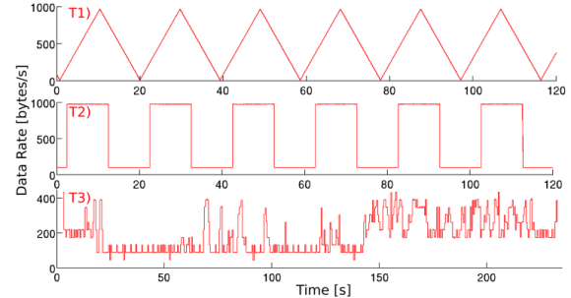
Related Work
Ref[3] determines the smallest length conflict tree for decreasing the latency in the WSN.
Ref[4] proposes sleeping schedules for contention and polling access schemes to extend the device lifetime.
Ref[5] proposes the novel power-management framework for BLE by scaling the connection interval during runtime.
Ref[6] presents the DIF in EDF scheduling to adjust the transmission rate with arbitrary individual deadline for minimizing the energy consumption.
● Write-request schedule
● Transmission rate
[4] Jacob, Anil K., and Lillykutty Jacob. "Energy Efficient MAC for QoS Traffic in Wireless Body Area Network." International Journal of Distributed Sensor Networks 2015 (2015).
[5] Doudou, Messaoud, et al. "Duo-MAC: Energy and time constrained data delivery MAC protocol in wireless sensor networks." Wireless Communications and Mobile Computing Conference (IWCMC), 2013 9th International. IEEE, 2013.
[6] P. Kindt, D. Yunge, M. Gopp and S. Chakraborty, “Adaptive online power-management for Bluetooth Low Energy”, IEEE Conference on Computer Communications (INFOCOM), 2015
[7] F. Shan, J. Luo, and X. Shen, “Optimal energy efficient packet scheduling with arbitrary individual deadline guarantee,” Compute. Netw., vol. 75, pp. 351–366, Dec. 2014
Notes:
Write-request scheduling
[3]以TDMA方式做collision avoid的問題，以最少的排列方式，減少傳輸時間上的消耗
不同點: 沒有energy上的節能
[4]在body sensor network環境下，做polling輪詢方式輪流詢問，目標為提升lifetime [運用設定各個node上的priority來做輪詢並且校正sleep time]
不同點: 雖然有energy saving 但未有real-time議題
Transmission rate
[5] 提出的BLE connection interval scaling framework, 針對energy consumption
不同處:沒有考量multiple node情況 沒有real time議題
[6] 提出間格調整rate方法，根據aperiodic task來做間格性調整
不同處: 沒有考量multiple node情況

Slide 9
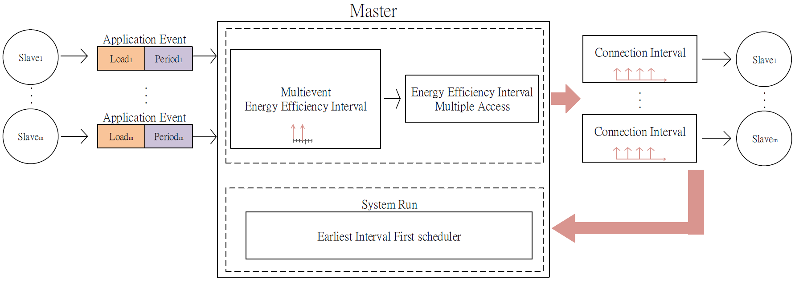
System Architecture
Master
Application Event
Slave1
Connection Interval
Slave1
Load1
Period1
MEI
EIMA
Application Event
Periodm
Connection Interval
Slavem
Slavem
Loadm
EIF
Multiple Event Energy Efficiency Interval (MEI)➔Estimating the service interval for each node.
Energy Efficiency Interval Multiple Access (EIMA) ➔Estimating the connection interval for each node in WSN.
Earliest Interval First (EIF) ➔Scheduling each node to receive the sensing data.
Notes:
系統架構中包含…(MEI) (EIMA)
之後緊接著為網路的架構圖

Slide 10
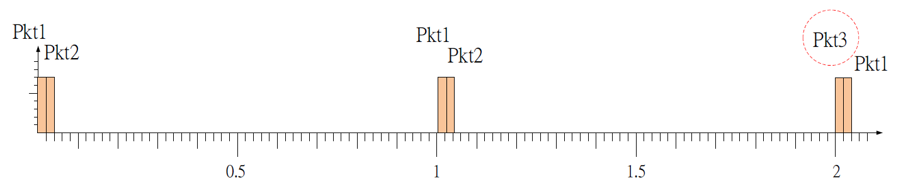
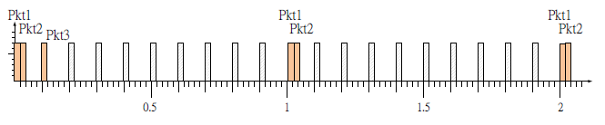
Service Interval
●Assign Interval
-Without data rate consideration
●Assumption
- In the follow example, we assume that there are two packets could be sent for one connection event.
●Assign Interval
-In the default setting for interval, it doesn’t consider the sensor sample rate and energy consumption.
●Assumption
- In the follow example, we assume that there are two packets could be sent for one connection event.
Input
Slave | Pkt1(20bytes, 1s) Pkt2(20bytes, 1s) Pkt3(20bytes, 2s)
Minimum period as interval →1s
Minimum interval→0.1s
MISS
Inteval→1s
Inteval→0.1s

Slide 11
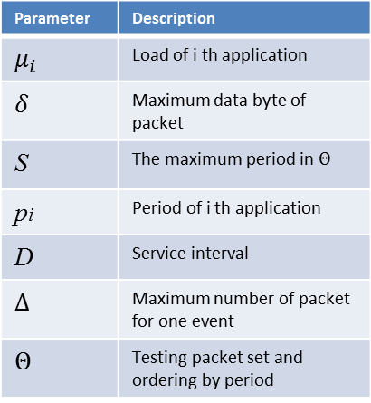



Proposal (Service Interval)
Parameter | Description
$$μ_{i}$$ | Load of i th application
$$δ$$ | Maximum data byte of packet
S | The maximum period in $Θ$
pi | Period of i th application
D | Service interval
$$∆$$ | Maximum number of packet for one event
$$Θ$$ | Testing packet set and ordering by period
● Multiple Event Energy Efficient Interval (MEI)
-Service interval with varied data rate
● Algorithm
-Demand packets (Periodic event)
-Supply packets (Particular connection interval)
$$\sum_{pkt ε Θ}^{Θ}{\left\lceil \frac{μ_{i}}{δ}\right\rceil ×\left\lceil \frac{S}{p_{i}}\right\rceil ≤}\left\lfloor \frac{S}{D}\right\rfloor ×∆$$
$$S$$
Demand packets
Supply packets
$$D$$
$Θ$➔The packet set, included the period of each packet is not bigger than $S$
$$δ\text{➔}\text{The} \text{payload} \text{for} \text{one} \text{packet} \text{and} \text{is} \text{set} \text{as}\text{ 20}\text{bytes} \text{of} \text{BLE} \text{protocol}\text{.}$$
Notes:
S & $Θ$要提及

Slide 12
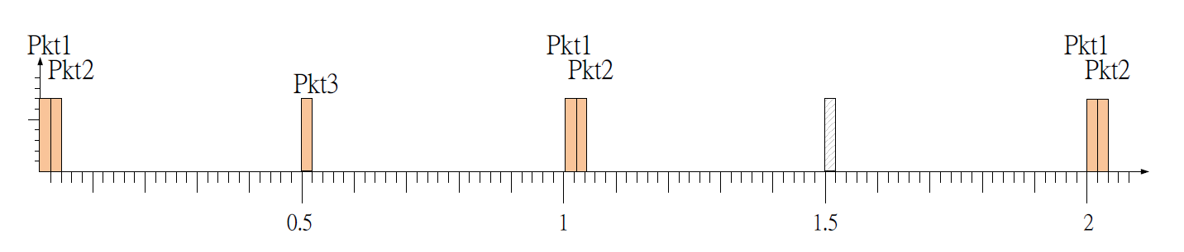
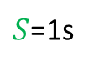
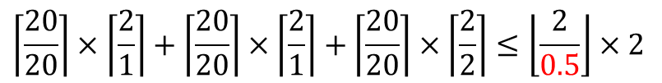
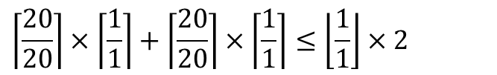
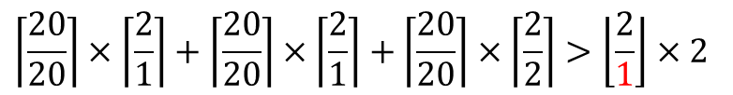
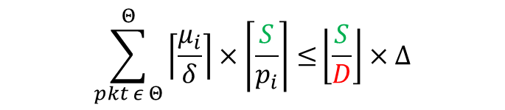

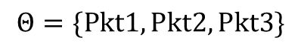
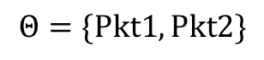
MEI Example
●Service Interval
-Demand packet v.s. Supply packet
Input
Slave | Pkt1(20bytes, 1s) Pkt2(20bytes, 1s) Pkt3(20bytes, 2s)
$$\sum_{pkt ε Θ}^{Θ}{\left\lceil \frac{μ_{i}}{δ}\right\rceil ×\left\lceil \frac{S}{p_{i}}\right\rceil ≤}\left\lfloor \frac{S}{D}\right\rfloor ×∆$$
$S$=1s
$$Θ=\{Pkt1, Pkt2\}$$
$$\left\lceil \frac{20}{20}\right\rceil ×\left\lceil \frac{1}{1}\right\rceil +\left\lceil \frac{20}{20}\right\rceil ×\left\lceil \frac{1}{1}\right\rceil ≤\left\lfloor \frac{1}{1}\right\rfloor ×2$$
$S$=2s
$$Θ=\{Pkt1, Pkt2, Pkt3\}$$
$$\left\lceil \frac{20}{20}\right\rceil ×\left\lceil \frac{2}{1}\right\rceil +\left\lceil \frac{20}{20}\right\rceil ×\left\lceil \frac{2}{1}\right\rceil +\left\lceil \frac{20}{20}\right\rceil ×\left\lceil \frac{2}{2}\right\rceil >\left\lfloor \frac{2}{1}\right\rfloor ×2$$
$$\left\lceil \frac{20}{20}\right\rceil ×\left\lceil \frac{2}{1}\right\rceil +\left\lceil \frac{20}{20}\right\rceil ×\left\lceil \frac{2}{1}\right\rceil +\left\lceil \frac{20}{20}\right\rceil ×\left\lceil \frac{2}{2}\right\rceil ≤\left\lfloor \frac{2}{0.5}\right\rfloor ×2$$
Notes:
最後要repeat
因此在我們的方法會考量各個sensor node上data rate議題，進而達到省能且提供優良的quality
Single node上會考量data rate議題，若擴展成multiple node型態 就會有blocking time上的問題點

Slide 13
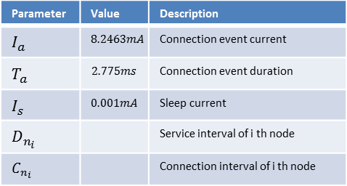
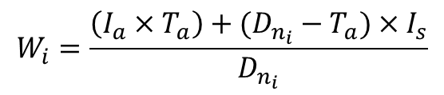
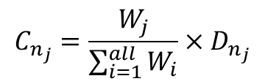
Proposal (Star Interval)
Parameter | Value | Description
$$I_{a}$$ | $$8.2463mA$$ | Connection event current
$$T_{a}$$ | $$2.775ms$$ | Connection event duration
$$I_{s}$$ | $$0.001mA$$ | Sleep current
$$D_{n_{i}}$$ |  | Service interval of i th node
$$C_{n_{i}}$$ |  | Connection interval of i th node
● Energy Efficiency Interval Multiple Access (EIMA)
-To prolong lifetime with collision problem.
$$W_{i}=\frac{\left(I_{a}×T_{a}\right)+(D_{n_{i}}−T_{a})×I_{s}}{D_{n_{i}}}$$
Consider to lifetime
$$C_{n_{j}}=\frac{W_{j}}{\sum_{i=1}^{all}{W_{i}}}×D_{n_{j}}$$
Consider to each slave
W1
W2
W3
Notes:
補圖片
(加入decrease程度 圖)

Slide 14
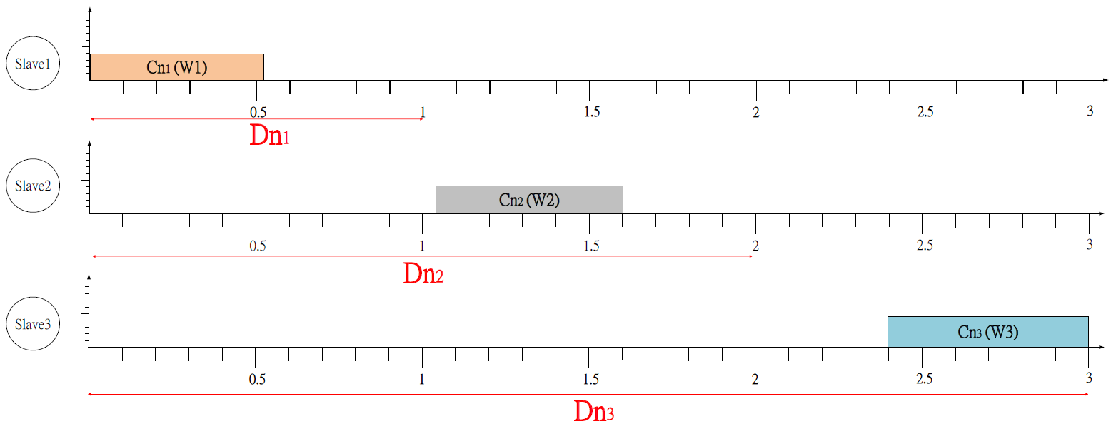
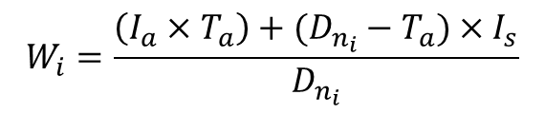
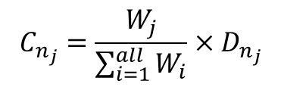
Proposal (Star Interval)
Parameter | Value | Description
$$I_{a}$$ | $$8.2463mA$$ | Connection event current
$$T_{a}$$ | $$2.775ms$$ | Connection event duration
$$I_{s}$$ | $$0.001mA$$ | Sleep current
$$D_{n_{i}}$$ |  | Service interval of i th node
$$C_{n_{i}}$$ |  | Connection interval of i th node
● Energy Efficiency Interval Multiple Access (EIMA)
 | Service Interval | W | C
Slave1 | 1000ms | 0.02306 | 530ms
Slave2 | 2000ms | 0.01203 | 553ms
Slave3 | 3000ms | 0.00835 | 576ms
$$W_{i}=\frac{\left(I_{a}×T_{a}\right)+(D_{n_{i}}−T_{a})×I_{s}}{D_{n_{i}}}$$
$$C_{n_{j}}=\frac{W_{j}}{\sum_{i=1}^{all}{W_{i}}}×D_{n_{j}}$$
Slave1
Slave2
Slave3
Notes:
proglong lifetime with collision constraint

Slide 15
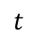
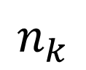
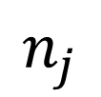
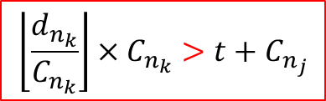
Proposal (Write-Request Scheduler)
● Write-Request Schedule
-Implements table order to notify device.
● Earliest Interval First Schedule (EIF)
- Period of slave (Service Interval by MEI)
- Interval of slave (Connection Interval by EIMA)
- EDF scheduler
- Decision equation
$$\left\lfloor \frac{d_{n_{k}}}{C_{n_{k}}}\right\rfloor ×C_{n_{k}}>t+C_{n_{j}}$$
$$t$$
Arrival
Deadline
$$n_{k}$$
$$n_{j}$$
Arrival
Deadline
Notes:
預測是否會被其他slave block
dn1/cn1 >>> d1時間內會來幾次*cn1 >>>下次來的時間 >>> 看是否小於 t + cn3(目前) >>> 即可知會不會被block

Slide 16
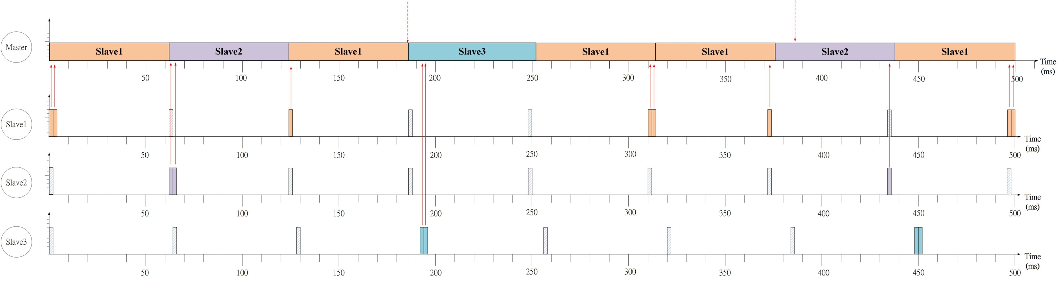
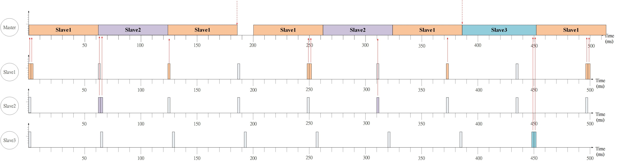
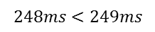
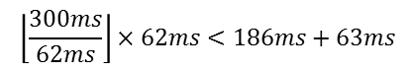
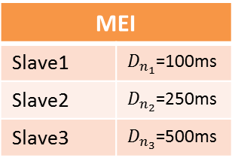
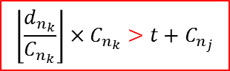
Example
Input
Slave1 | Pkt1(10bytes, 100ms) Pkt2(10bytes, 200ms)
Slave2 | Pkt1(10bytes, 500ms) Pkt2(30bytes, 500ms)
Slave3 | Pkt1(10bytes, 1000ms) Pkt2(10bytes, 1000ms) Pkt3(10bytes, 1000ms)
EIMA
 | Waiting Time | Period (MEI)
 | 62ms | 100ms
 | 62ms | 250ms
 | 63ms | 500ms
MEI
Slave1 | $D_{n_{1}}$=100ms
Slave2 | $D_{n_{2}}$=250ms
Slave3 | $D_{n_{3}}$=500ms
Slave1
Slave2
$$\left\lfloor \frac{300ms}{62ms}\right\rfloor ×62ms<186ms+63ms$$
Slave3
$$\left\lfloor \frac{d_{n_{k}}}{C_{n_{k}}}\right\rfloor ×C_{n_{k}}>t+C_{n_{j}}$$
$$248ms<249ms$$
Master
249
miss
Slave1
248
Slave2
Slave3

Slide 17
Experiment
● Setting
- Input: Data rate is near 80bytes/s-440bytes/s for each device
Sample period is near 200ms, 400ms and 800ms
- Topology: Star topology (3 slave nodes)
- Single node interval: MEI (v.s. Lazy[1], DIF[2], and Greedy)
- Scaling interval in network algorithm: EIMA (v.s. LDC[3], and Greedy)
- Write-request schedule: EIF (v.s. Polling[4], Round Robin, and NPEDF[5])
● Performance Evaluation
-Meet ratio: Evaluate the ratio of meet packet to total amount of packet
-Lifetime : Evaluate the shortest lifetime of network
[1] P. Kindt, D. Yunge, M. Gopp and S. Chakraborty, “Adaptive online power-management for Bluetooth Low Energy”, IEEE Conference on Computer Communications (INFOCOM), 2015
[2] F. Shan, J. Luo, and X. Shen, “Optimal energy efficient packet scheduling with arbitrary individual deadline guarantee,” Compute. Netw., vol. 75, pp. 351–366, Dec. 2014
[3] Doudou, Messaoud, et al. "Duo-MAC: Energy and time constrained data delivery MAC protocol in wireless sensor networks." Wireless Communications and Mobile Computing Conference (IWCMC), 2013 9th International. IEEE, 2013.
[4] Jacob, Anil K., and Lillykutty Jacob. "Energy Efficient MAC for QoS Traffic in Wireless Body Area Network." International Journal of Distributed Sensor Networks 2015 .
[5] Collotta, Mario, Giovanni Pau, and Gianfranco Scatà. "Deadline-aware scheduling perspectives in industrial wireless networks: A comparison between IEEE 802.15. 4 and Bluetooth." International Journal of Distributed Sensor Networks 2013 (2013).
Notes:
簡介一下比較組

Slide 18
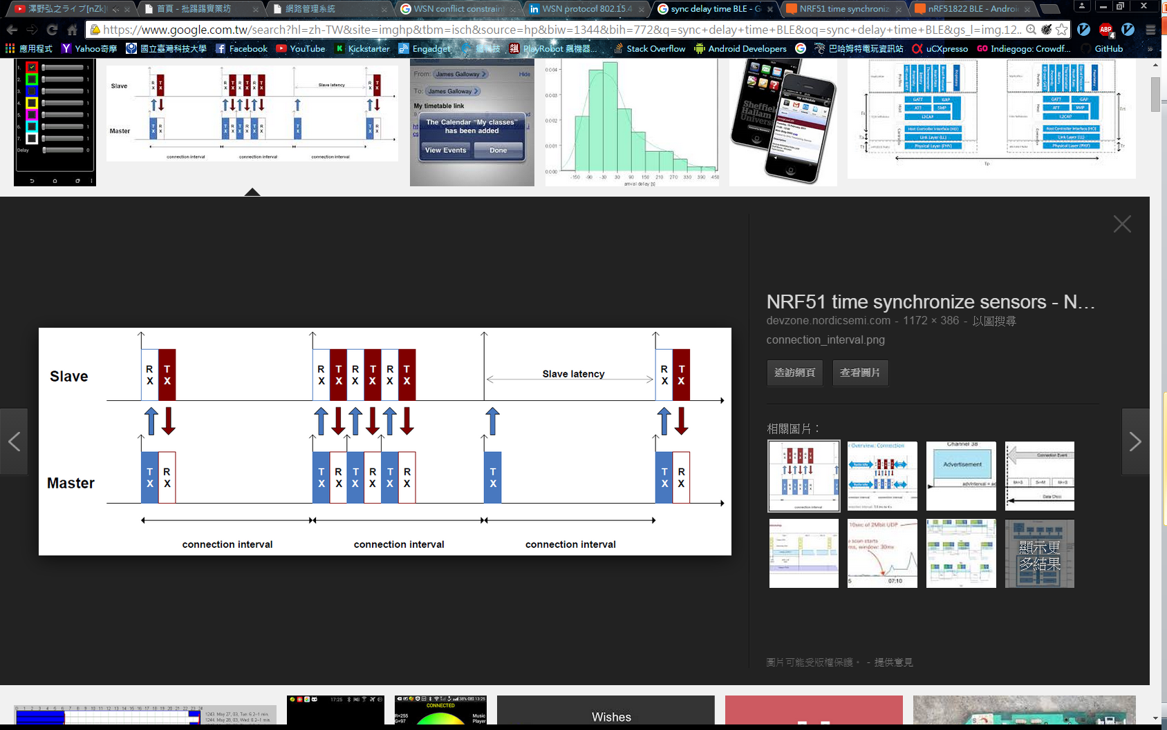
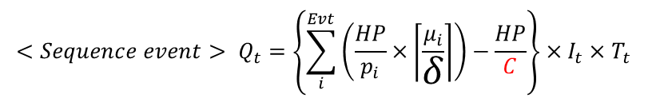
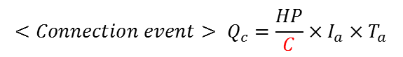
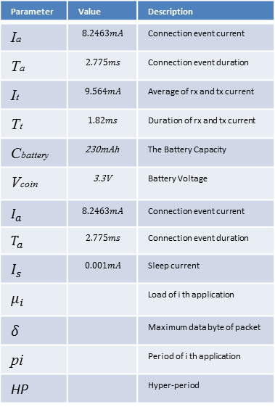

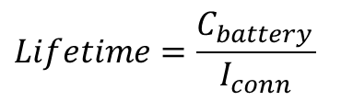
Lifetime Model
Parameter | Value | Description
Ia | $$8.2463mA$$ | Connection event current
Ta | $$2.775ms$$ | Connection event duration
It | $$9.564mA$$ | Average of rx and tx current
Tt | $$1.82ms$$ | Duration of rx and tx current
Cbattery | 230mAh | The Battery Capacity
Vcoin | 3.3V | Battery Voltage
$$I_{a}$$ | $$8.2463mA$$ | Connection event current
$$T_{a}$$ | $$2.775ms$$ | Connection event duration
$$I_{s}$$ | $$0.001mA$$ | Sleep current
$$μ_{i}$$ |  | Load of i th application
$$δ$$ |  | Maximum data byte of packet
pi |  | Period of i th application
HP |  | Hyper-period
●Node power model
$$<Connection event> Q_{c}=\frac{HP}{C}×I_{a}×T_{a}$$
$$<Sequence event> Q_{t}=\left\{\sum_{i}^{Evt}{\left(\frac{HP}{p_{i}}×\left\lceil \frac{μ_{i}}{δ}\right\rceil \right)−\frac{HP}{C}}\right\}×I_{t}×T_{t}$$
$$I_{conn}=\frac{\left\{{(Q}_{c}+Q_{t}\right)+I_{s}×(HP−\frac{Q_{c}}{I_{a}}−\frac{Q_{t}}{I_{t}})\}}{HP}$$
$$P_{conn}=I_{conn}×V_{coin}$$
$$Lifetime=\frac{C_{battery} }{I_{conn}}$$
Measuring Bluetooth® Low Energy Power Consumption

Slide 19
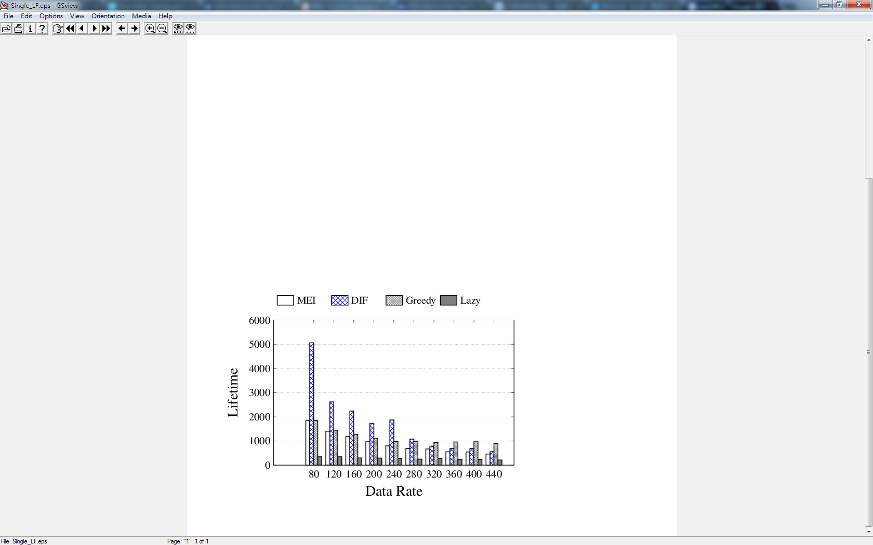
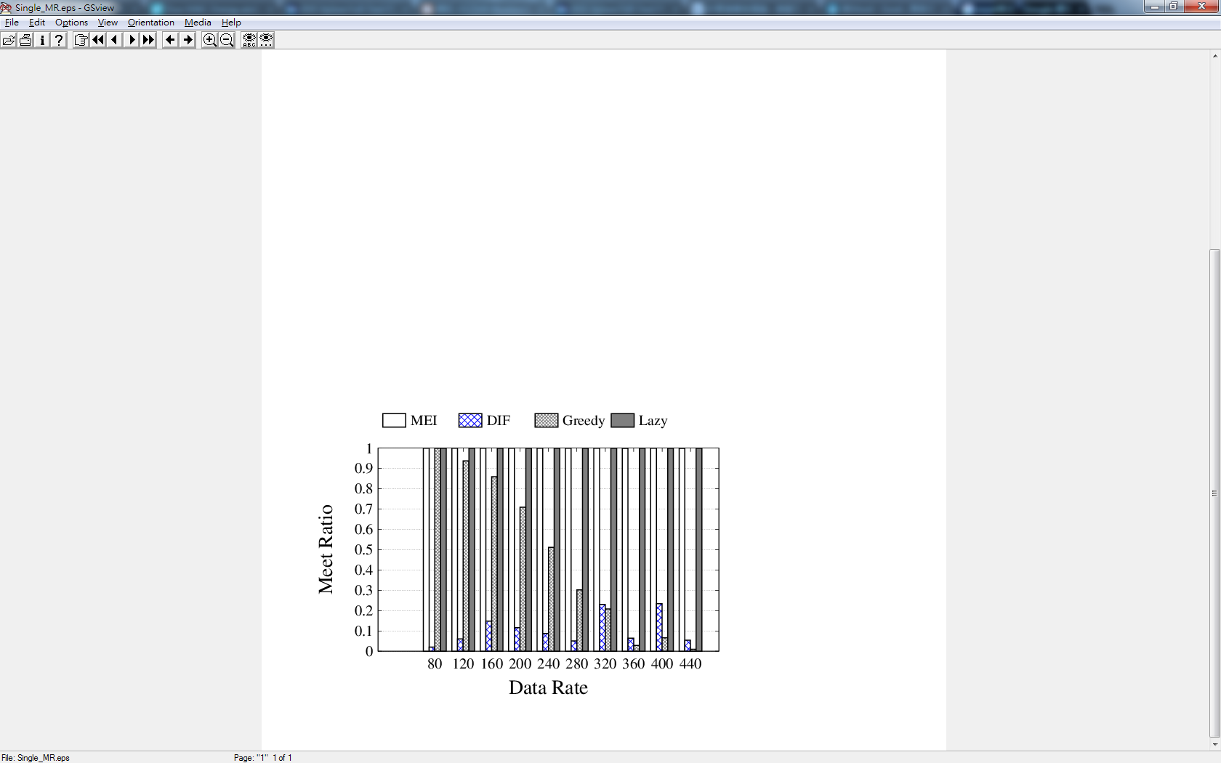
Experiment (Service Interval)
● Single Node
(MEI, DIF, Lazy, and Greedy)
➔ Lazy proposes to gradually decrease the BLE rate by constant value and assign the highest rate to server application when the application rate is larger than BLE rate.
➔ DIF proposes to estimate the interval application rate and assign the BLE rate to every packet.
➔ Greedy would assign the minimum period as the connection interval.
Notes:
Meet ratio
Latency
Lifetime
DIF➔320, 480為(80bytes倍數)

Slide 20
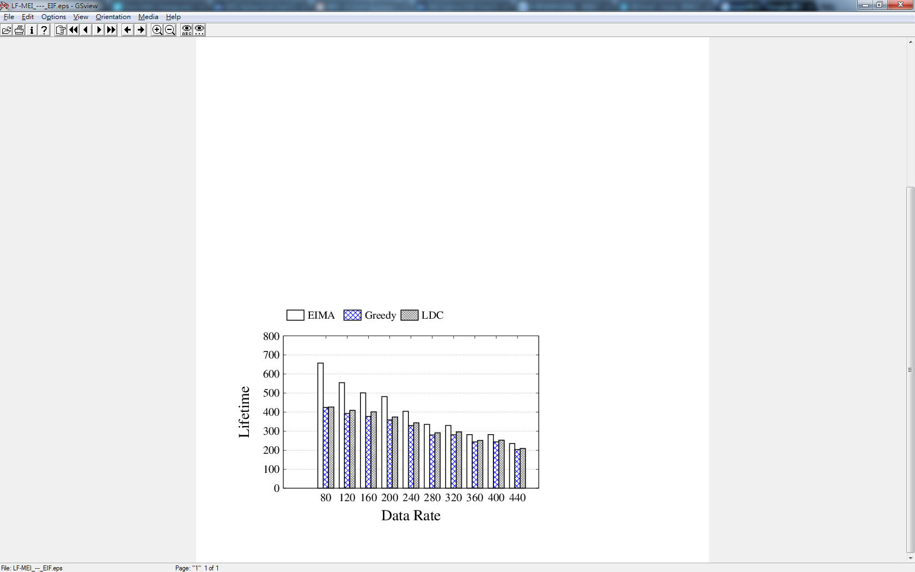
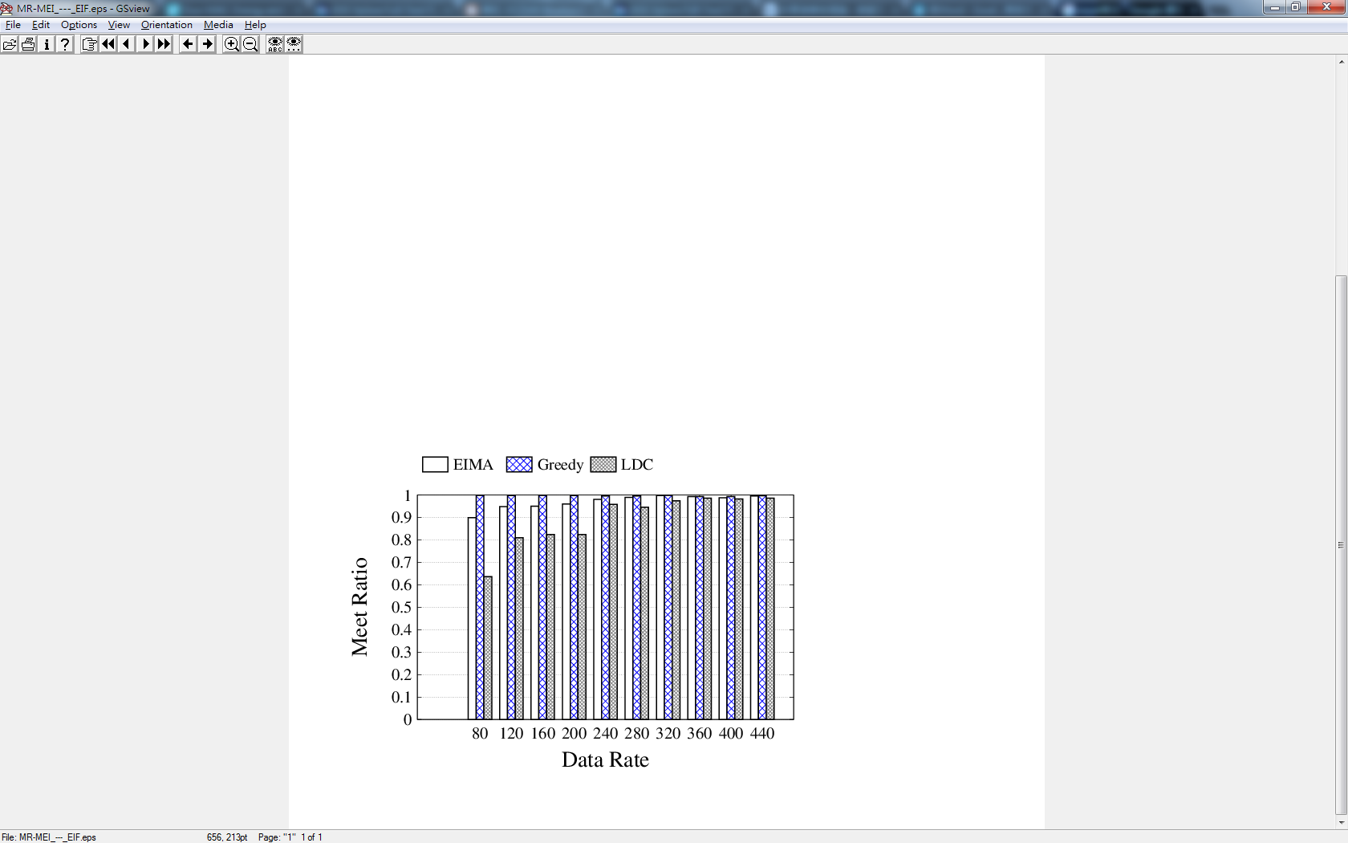
Experiment (Star Interval)
● Scaling Connection Interval
(EIMA, LDC, and Greedy)
➔ LDC proposes to use the low duty cycle to server the application and each interval would be divided by number of node to be the connection interval.
➔ Greedy proposes to let the minimum interval to be divided by number of node and assign as connection interval for every node.
Notes:
Single node -> MEI
Mesh node -> TDMA, EIMA
Latency 為何會往下墜?
1.Input 中每一node的data rate相同，若時間越短 Load加重造成pkt數量不會有帶大的改變, 反之時間越常造成load變大, pkt數量顯而易見
2.

Slide 21
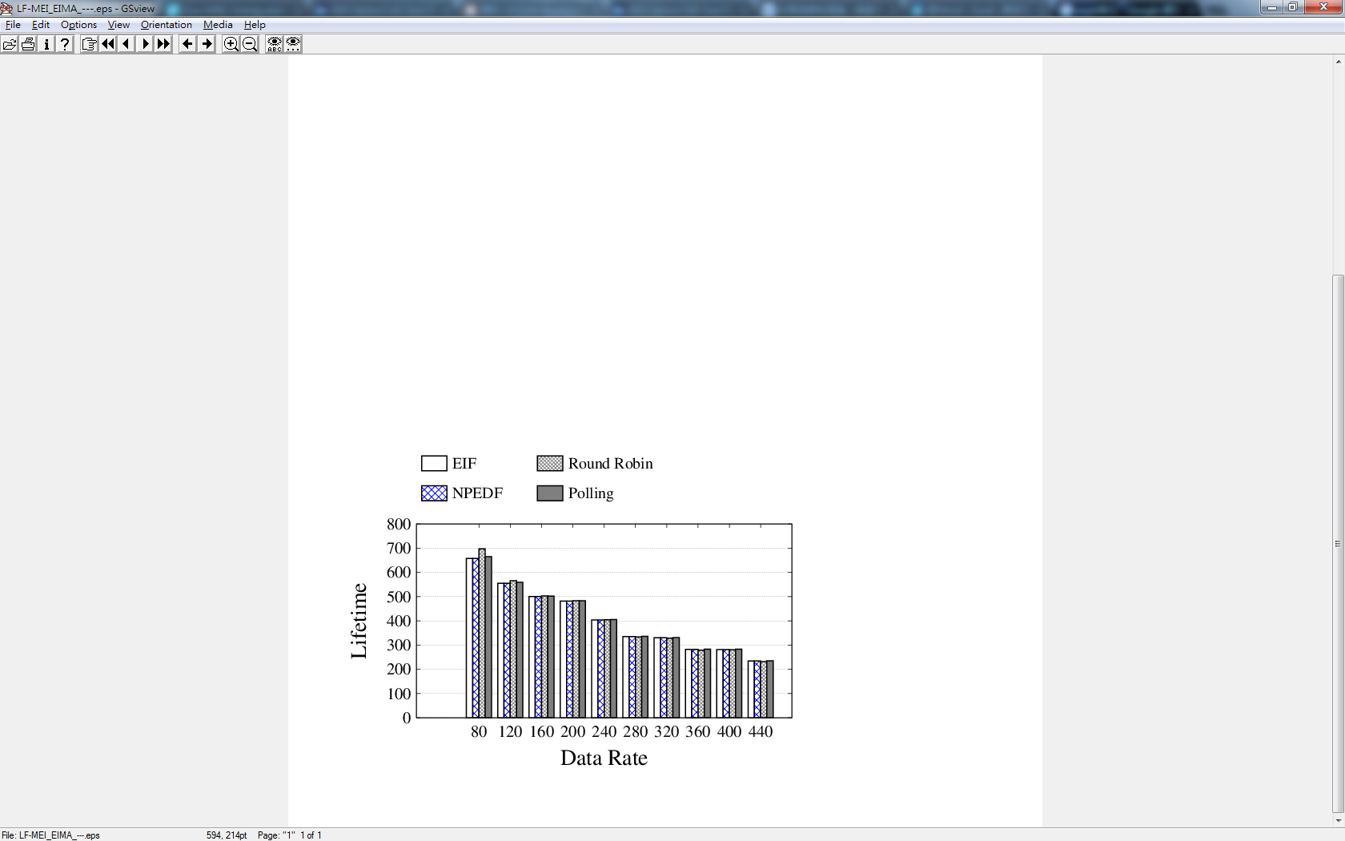
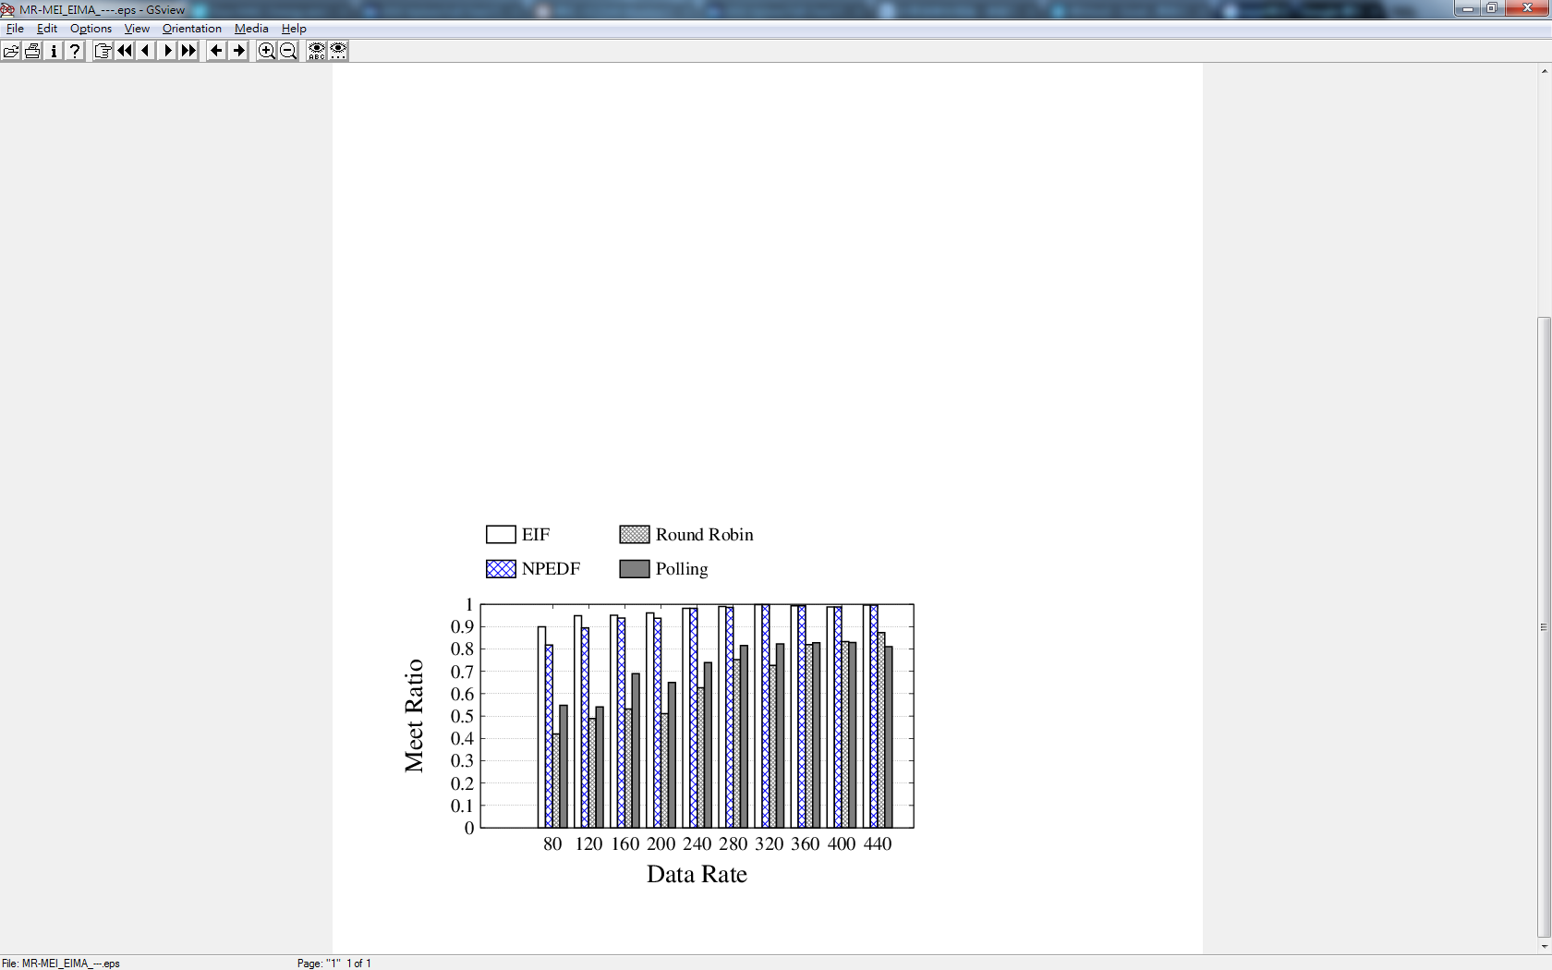
Experiment (Write-Request Scheduler)
● Write-Request Schedule
(EIF, Polling, NPEDF, and Round Robin)
➔ NPEDF proposes to schedule as the Earliest Deadline First in non-preemptive.
➔ Polling proposes assign the schedule table by priority of node.
➔ Round Robin proposes assign the schedule table and assign each one time.
Notes:
Single node -> MEI
Mesh node -> TDMA, EIMA

Slide 22
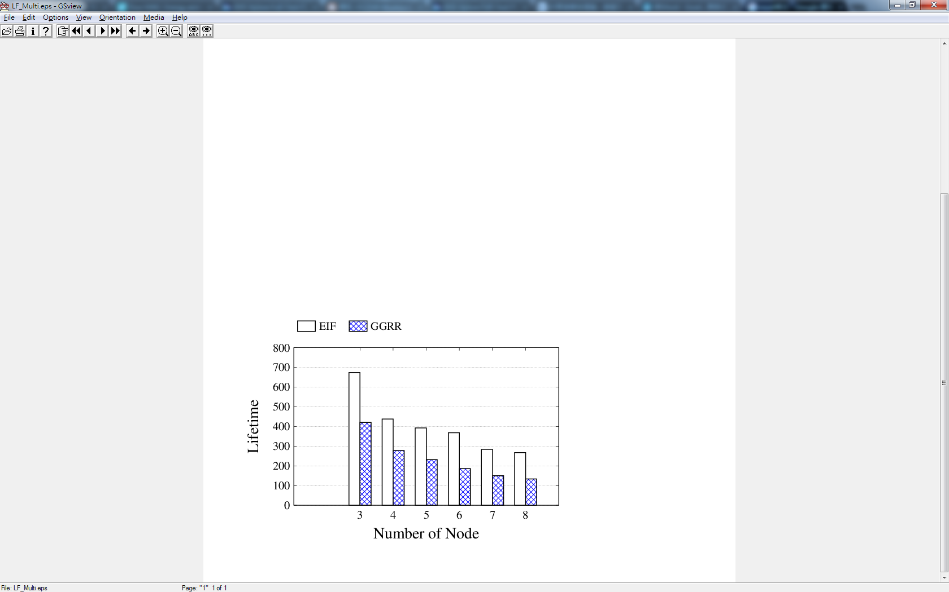
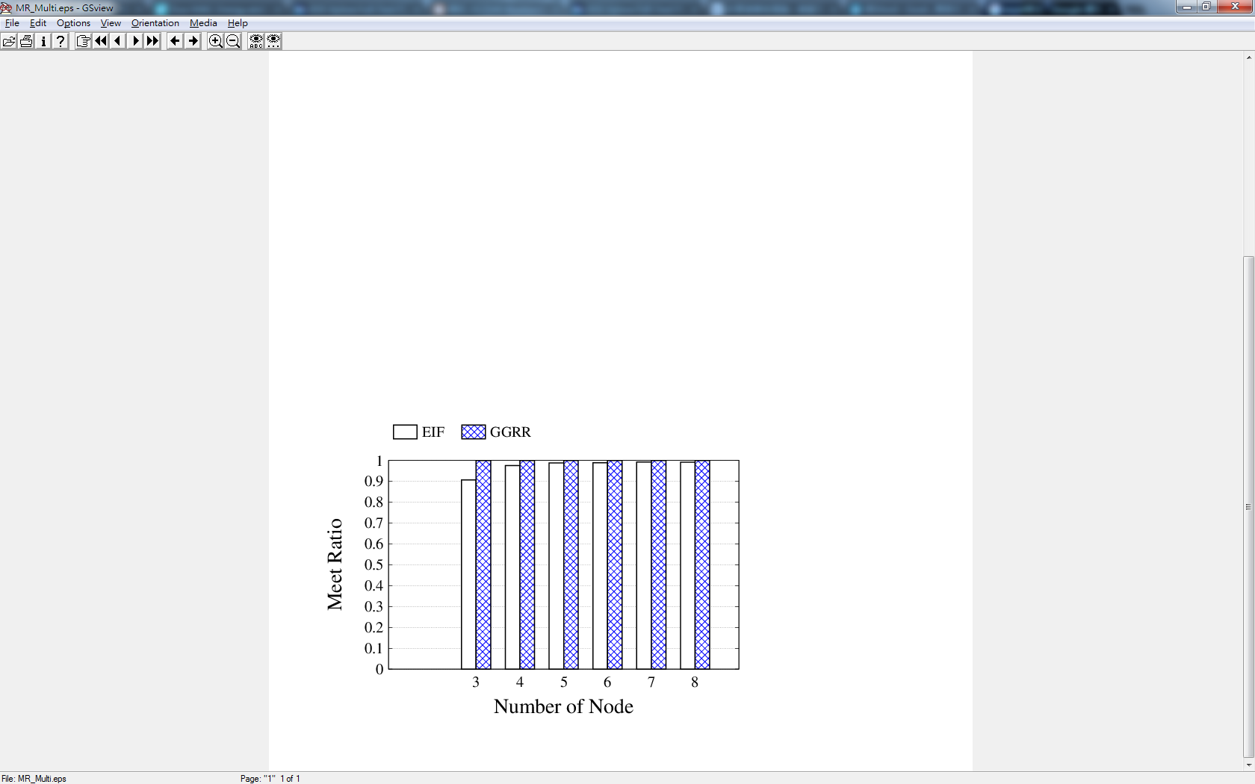
Experiment (Varied Node Number)
● Node Number
(80bytes/s)
GGRR=Greedy Greedy Round Robin
Notes:
Single node -> MEI
Mesh node -> TDMA, EIMA

Slide 23
Experiment (Service Interval)
● Single Node
(MEI, DIF, Lazy, and Greedy)
➔ Lazy proposes to gradually decrease the BLE rate by constant value and assign the highest rate to server application when the application rate is larger than BLE rate.
➔ DIF proposes to estimate the interval application rate and assign the BLE rate to every packet.
➔ Greedy would assign the minimum period as the connection interval.
Notes:
Meet ratio
Latency
Lifetime
DIF➔320, 480為(80bytes倍數)

Slide 24
Experiment (Star Interval)
● Scaling Connection Interval
(EIMA, LDC, and Greedy)
➔ LDC proposes to use the low duty cycle to server the application and each interval would be divided by number of node to be the connection interval.
➔ Greedy proposes to let the minimum interval to be divided by number of node and assign as connection interval for every node.
Notes:
Single node -> MEI
Mesh node -> TDMA, EIMA
Latency 為何會往下墜?
1.Input 中每一node的data rate相同，若時間越短 Load加重造成pkt數量不會有帶大的改變, 反之時間越常造成load變大, pkt數量顯而易見
2.

Slide 25
Experiment (Write-Request Scheduler)
● Write-Request Schedule
(EIF, Polling, NPEDF, and Round Robin)
➔ NPEDF proposes to schedule as the Earliest Deadline First in non-preemptive.
➔ Polling proposes assign the schedule table by priority of node.
➔ Round Robin proposes assign the schedule table and assign each one time.
Notes:
Single node -> MEI
Mesh node -> TDMA, EIMA

Slide 26
Experiment (Varied Node Number)
● Node Number
(80bytes/s)
Notes:
Single node -> MEI
Mesh node -> TDMA, EIMA

Slide 27
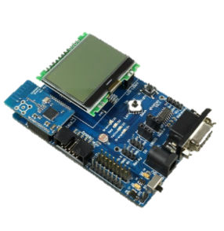

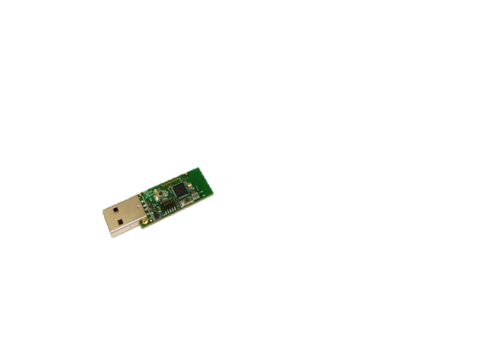
Case Study
●Wireless Body Sensor Network
-Emergence scenario
-Real-time delivery
●Architecture
-Star topology with three slaves
CC2540/CC2541
Device Type | Wireless MCU
Bluetooth Standard | Bluetooth Smart (Bluetooth low energy)
Flash size (KB) | 128 256
RAM size (KB) | 8
RX Current (Lowest) (mA) | 19.6
Standby Current (uA) | 0.4
Wakeup Time (PD-->RX/TX) (us) | 530
Sensitivity (Best) (dBm) | -93
Operating Temperature Range (C) | -40 to 85
http://www.ti.com/product/CC2540
Notes:
Power function上的考量

Slide 28


Case Study
●Implement
- GATTMsg →Receive request message and Response
- Buffer Queue →Manage sensing data
- Write-request schedule is controlled by the master.
MEI
OSAL
Peripheral
Profile
Application
GATTMsg
Buffer Queue
EIMA
Host
Callback Function
EIF
GATT
Host Control Interface (HCI)
Controller
HCI
BLE Stack
Notes:
Buffer Queue➔若沒有BufferQueue會以各自service觸發notification
導致切換node時 packet loss
GATTMsg➔已我們的write-request方式，避免等待過長時間

Slide 29
Experiment
● Setting
Input |  | Connection interval (EIMA) | Connection interval (Greedy)
Slave1 | Pkt1(8bytes, 200ms) Pkt2(8bytes, 200ms) | 100ms | 50ms
Slave2 | Pkt1(16bytes, 400ms) Pkt2(16bytes, 400ms) | 100ms | 50ms
Slave3 | Pkt1(20bytes, 800ms) Pkt2(20bytes, 800ms) | 100ms | 50ms

Slide 30
Conclusion
●In the WSN, it is hard to balance the power consumption and latency of each sensor node with real-time and collision constraint.
●We propose MEI to determine the interval with varied data rate.
EIMA to extend the lifetime of network with collision constraint.
EIF to decrease the latency by defining device’s priority.
●In our simulation and practice, it is obviously to see our proposal has the better performance in meet ratio and high lifetime for the whole sensor network.

Slide 31
Experiment
● Setting

Slide 32
Experiment
● Setting

Slide 33
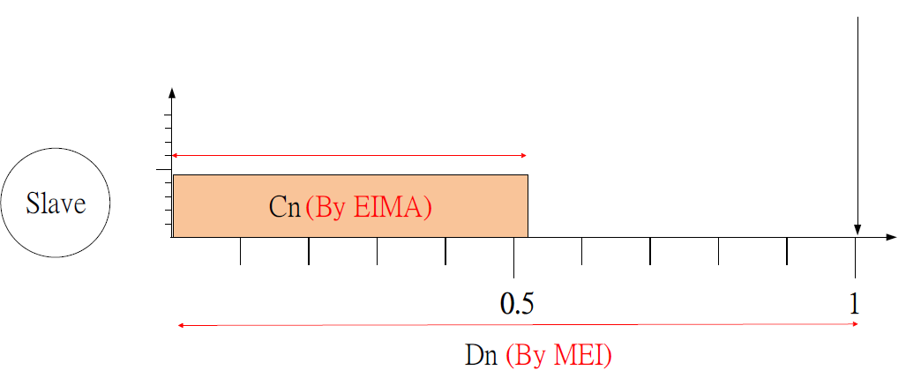


Proposal (Write-Request Scheduler)
● Write-Request Schedule
-The write-request scheduler usually implements the table order to notify device.
● Earliest Interval First Schedule (EIF)
-The MEI define the urgent interval for each node, and assign as period of each node.
-The EIMA is estimated for device transmission duration for avoid collision problem.
- The scheduler proposes to decide whether the node ($n_{k}$), not arrival would be blocking by other node ($n_{j}$).
$$\left\lfloor \frac{d_{n_{k}}}{C_{n_{k}}}\right\rfloor ×C_{n_{k}}>t+C_{n_{j}}$$
N1
Frame1(N1)
Frame3(N3)
N2
GW
Frame2(N2)
N3
Notes:
預測是否會被其他slave block

Slide 34



Proposal (Star Interval)
Parameter | Value | Description
$$I_{a}$$ | $$8.2463mA$$ | Connection event current
$$T_{a}$$ | $$2.775ms$$ | Connection event duration
$$I_{s}$$ | $$0.001mA$$ | Sleep current
$$D_{n_{i}}$$ |  | Service interval of i th node
$$C_{n_{i}}$$ |  | Connection interval of i th node
● Energy Efficiency Interval Multiple Access (EIMA)
-It determine the waiting time for master to each node with avoiding collision.
-It can balance network energy consumption for each node to extend lifetime.
$$W_{i}=\frac{\left(I_{a}×T_{a}\right)+(D_{n_{i}}−T_{a})×I_{s}}{D_{n_{i}}}$$
Consider to lifetime
$$C_{n_{j}}=\frac{W_{j}}{\sum_{i=1}^{all}{W_{i}}}×D_{n_{j}}$$
Consider to each slave
$$\frac{C_{n_{1}}}{D_{n_{1}}}+\frac{C_{n_{2}}}{D_{n_{2}}}+\frac{C_{n_{3}}}{D_{n_{3}}}≤1$$
Notes:
將current當為weight
考量彼此slave
U=1

Slide 35


Node scheduler
● Property
→Event-driven
● Issue
→The interval between both events
is the critical point for energy efficiency.
→Sleeping time can lower the current.
● Improve
→Buffer assignment
→BLE stack <Peripheral>
Buffer
Pkt
Pkt
…
Pkt
Notes:
OSAL

Slide 36

Discovery issue
Parameter | Description
Tproc,disc | Discovery processing time, affected by duty cycle of scan window
Nadv | Amount of advertisment device
Tscan_inter | Scan interval for switching listen channel
Tscan_win | Scan window for listensing chnnel
Tadv | Advertisement interval
● Discovery process /latency
-The response data, sent by advertising node should be only allowed for one pattern.
-Duty cycle of scan process effects the discovery time.
-The critical delay time is coming from the advertising interval (Ta).
$$T_{Dis}\left(T_{a}, N_{adv}\right)=(0.5×T_{a}+T_{proc,disc})×e^{\frac{2N_{adv}}{3(0.5×T_{a}+T_{proc,disc})}}$$
Conn
Adv
$T_{proc,disc}=b×\frac{T_{scan_win}}{T_{scan_inter}}+T_{adv}×\frac{T_{scan_inter}−T_{scan_win}}{T_{scan_inter}}$, if $T_{adv}+T_{scan_win}>T_{scan_inter}$
● J. Liu et.al., ”Modeling and performance analysis of device discovery in Bluetooth Low Energy networks,” Proc. IEEE Global Commun. Conf., Anaheim, CA, USA, 2012, pp.1538-1543
● Jan Jaap Treurniet, Chayan Sarkar, R. Venkatesha Prasad, Willem de Boer “Energy Consumption and Latency in BLE Devices under Mutual Interference: An Experimental Study”, 2015
Notes:
Modeling and Performance Analysis of Device Discovery in Bluetooth Low Energy Networks
(雖然duty cycle對於delay time有影響，另一方面若duty cycle為1但scan window 帶過長，因LL曾是必須等到scan window 結束才會response ，因此時間也不可過長)

Slide 37


Measure
$$\text{●} Connection \& Advertisement interval$$
Interval = 10ms
Interval = 2000ms

Slide 38


Measure
$$\text{●}Connection \& Advertisement event$$
Connection event
Advertisement event
Notes:
為何不全部用Advertisement?
因一event上會有額外的消耗 (37, 38 39)

Slide 39




Measure
$$\text{●} Sequence packet$$
Single packet
Multiple packets
$$\text{●} Scan current$$
Scan
Notes:
Power function上的考量

Slide 40


BLE State
● BLE State (Link Layer)
-The state of sequence packet transmission stays in connection.
-In multiple notification issue, if two slaves response data to master, the buffer would be erased by the later arrival one.
http://wiki.t-firefly.com/index.php/FireBLE/protocol_stack/en
http://e2e.ti.com/support/wireless_connectivity/bluetooth_low_energy/f/538/p/375805/1323302#1323302
Notes:
Initial->Device waits to receive advertising packet from a specific device, and responds with connection request
Connection->Device exchanges data
Standby-> sleep
1.連傳機制會以現在的packet priority最高
導致其他node collision
2.若沒有BufferQueue會以各自service觸發notification
導致切換node時 packet loss
Adv > Conn
若有Adv node則為去監聽，之後再切回Conn (Buffer)

Slide 41

Mesh Network
● Mesh
-To establish sensor network for wide range, it allow the device to communicate to each others.
● Gateway (Central)
-It controls the write-request schedule and receives the sensing data.
● Conn Node (Peripheral and Observer)
-The sensor node is connecting to the gateway and scanning the date form the Adv node.
● Adv Node (Broadcaster)
-The sensor node is playing as advertising role and being as beacon, for broadcasting event.
http://ble-mesh.com/
Notes:
與lifetime equ串連

Slide 42




Proposal (Star Interval)
Parameter | Value | Description
$$I_{a}$$ | $$8.2463mA$$ | Connection event current
$$T_{a}$$ | $$2.775ms$$ | Connection event duration
$$I_{s}$$ | $$0.001mA$$ | Sleep current
$$C_{n_{i}}$$ |  | Connection interval of i th node
● Energy Efficiency Interval Multiple Access (EIMA)
.
Notes:
解碰撞 以及extend lifetime

Slide 43




Mesh Solution
Parameter | Description
Tproc,disc | Discovery processing time, affected by duty cycle of scan window
Nadv | Amount of advertisment device
Tscan_inter | Scan interval for switching listen channel
Tscan_win | Scan window for listensing chnnel
Tadv | Advertisement interval
●Lifetime and Latency
- The interval in Adv Node would cause the discovery latency and energy consumption in Conn Node and Adv Node.
-We propose to make the power consumption of Conn node same as that of Adv node.
$$T_{Dis}\left(T_{adv}, N_{adv}\right)=(0.5×T_{adv}+T_{proc,disc})×e^{\frac{2N_{adv}}{3(0.5×T_{adv}+T_{proc,disc})}}$$
$$\frac{\left\{{(Q}_{ci}+Q_{et}+Q_{dis}\right)+I_{sleep}(HP−\frac{Q_{ci}}{I_{ce}}−\frac{Q_{et}}{I_{rxtx}}−\frac{Q_{dis}}{I_{p}})\}}{HP}=\frac{I_{ce}×T_{ce}+I_{sleep}×{(T_{adv}−T}_{ce})}{T_{adv}}$$
$$Q_{dis}=\frac{HP}{Min\left\{{Period}_{j} \right|j∈Advset\}}×I_{p}×T_{Dis}\left(T_{adv}, N_{adv}\right)$$
Energy
Energy
$T_{adv}$
$$T_{Dis}$$
Conn
Adv
● J. Liu et.al., ”Modeling and performance analysis of device discovery in Bluetooth Low Energy networks,” Proc. IEEE Global Commun. Conf., Anaheim, CA, USA, 2012, pp.1538-1543
● Jan Jaap Treurniet, Chayan Sarkar, R. Venkatesha Prasad, Willem de Boer “Energy Consumption and Latency in BLE Devices under Mutual Interference: An Experimental Study”, 2015
Notes:
簡介一下比較組

Slide 44
Process Power
●Process power
217Hours
235Hours
Measuring Bluetooth® Low Energy Power Consumption

Slide 45




Power & Lifetime Model
Parameter | Value | Description
Ia | $$8.2463mA$$ | Connection event current
Ta | $$2.775ms$$ | Connection event duration
It | $$14.2744mA$$ | Average of rx and tx current
Tt | $$0.49ms$$ | Duration of rx and tx current
Cbattery | 230mAh | The Battery Capacity
Vcoin | 3.3V | Battery Voltage
$$I_{a}$$ | $$8.2463mA$$ | Connection event current
$$T_{a}$$ | $$2.775ms$$ | Connection event duration
$$I_{s}$$ | $$0.001mA$$ | Sleep current
$$μ_{i}$$ |  | Load of i th application
$$δ$$ |  | Maximum data byte of packet
pi |  | Period of i th application
HP |  | Hyper-period
●Node power model
$$<Connection event> Q_{c}=\frac{HP}{T_{c}}×I_{a}×T_{a}$$
$$<Extra event> Q_{t}=\left\{\sum_{i}^{Evt}{\left(\frac{HP}{p_{i}}×\frac{μ_{i}}{δ}\right)−\frac{HP}{T_{c}}}\right\}×I_{t}×T_{t}$$
$$<Discovery> Q_{dis}=\frac{HP}{Min\left\{{Period}_{j} \right|j∈Advset\}}×I_{p}×T_{Dis}\left(T_{a}, N_{adv}\right)$$
$$I_{conn}=\frac{\left\{{(Q}_{c}+Q_{t}+Q_{dis}\right)+I_{s}×(HP−\frac{Q_{c}}{I_{a}}−\frac{Q_{t}}{I_{t}}−\frac{Q_{dis}}{I_{p}})\}}{HP}$$
$$P_{conn}=I_{conn}×V_{coin}$$
$$Lifetime=\frac{C_{battery} }{I_{conn}}$$
Measuring Bluetooth® Low Energy Power Consumption

